Slide 1
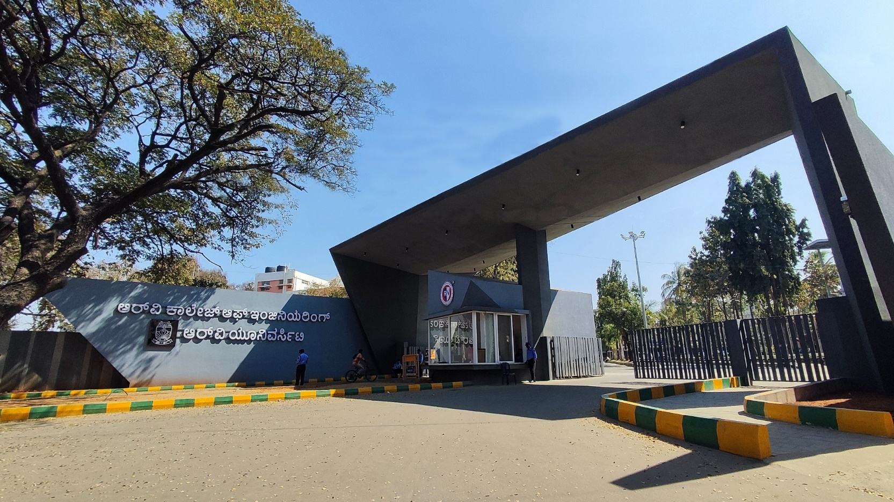
Scalable Agri-Assistance System
Theme - Environment

Slide 2

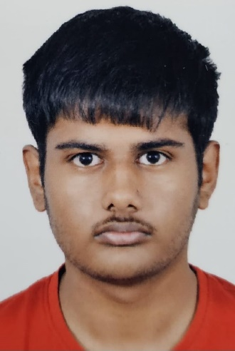
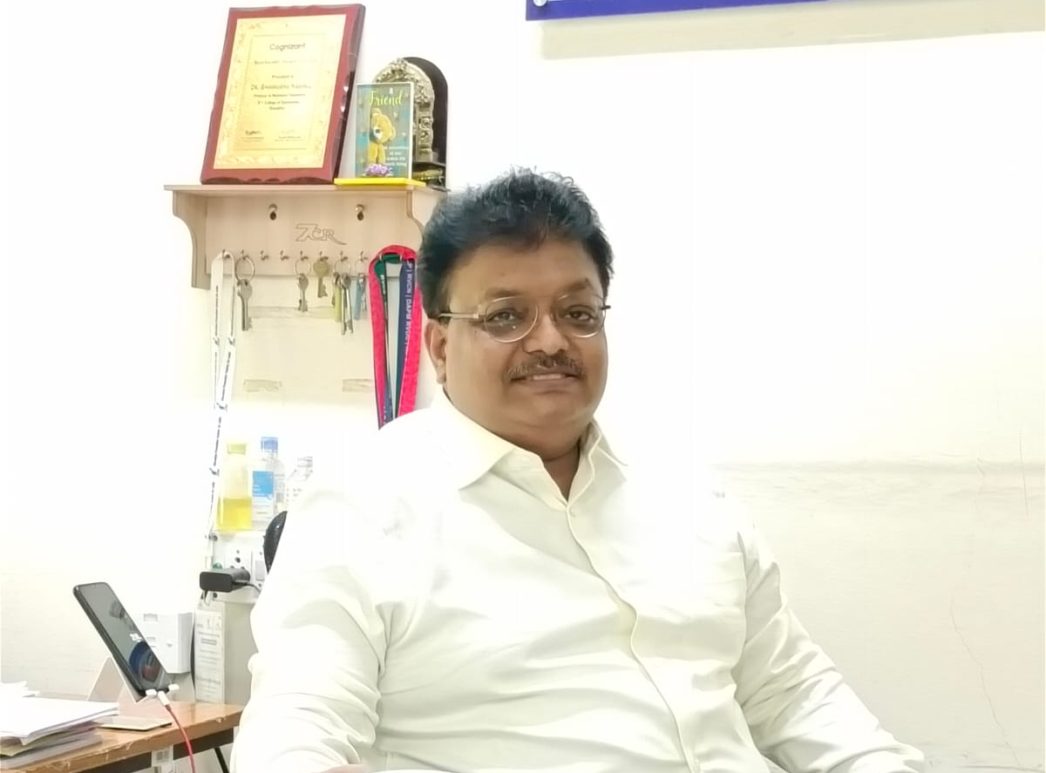

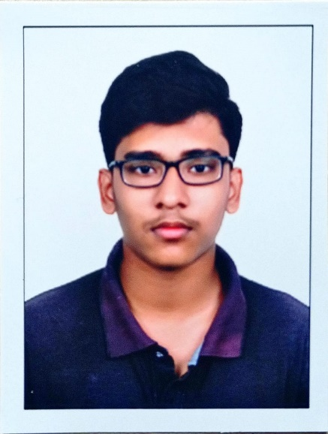
Scalable Agri-Assistance System
Pramath J
Samaraditya P H
Dr. Shanmukha Nagaraj
Dean Academics
Mechanical
Aditya Mallanagouda Yargal
Tejas N Naik

Slide 3
EL Phase-II
Presentation Outline
Introduction
Project Overview
Comments during EL Phase-I and action taken.
Tools and Techniques Used
Project Progress
Analysis of Partial Results
Deliverables and Outcomes
Future work (Remaining tasks)
Conclusion

Slide 4
Introduction
Our project focuses on developing a scalable agri-assistance system that uses sensors and real-time (by leveraging sensors) data to optimize irrigation and minimize pesticide usage.
This is crucial in addressing challenges like water scarcity, soil degradation, and inefficiency in resource management, especially for smallholder farmers.
In Phase 2, we aim to demonstrate the prototype’s functionality, showcasing its ability to measure soil moisture, temperature and humidity, and provide actionable insights. This phase focuses on proving scalability for larger fields, portability for deployment across scattered farmlands, and compactness for easy integration. Additionally, we aim to ensure the system is user-friendly

Slide 5
Project Overview
Small-holder farmers face challenges in managing water and pesticide usage due to a lack of affordable tools and real-time data. This results in resource wastage, soil degradation, groundwater contamination, and frequent travel for farm inspections, making traditional methods unsustainable.
Primary Objectives
Optimize irrigation using soil moisture sensors and weather data.
Reduce water waste and prevent over-irrigation.
Minimize pesticide use during unsuitable conditions.
Provide a scalable, user-friendly, and cost-effective solution for smallholder farmers.

Slide 6
Project Overview
Expected Impact
Enable data-driven decisions to conserve water and improve yields.
Reduce environmental contamination and promote sustainability.
Support cost-effective farming practices, enhancing agricultural efficiency.

Slide 7
Comments during EL Phase-I and action taken
Definition of Methodology and Timeline separately
Updated in the Phase-1 Presentation
More research on recent (2020-present) articles and journals
Found 2 new journals/articles
Mentor advice – Research Data on the current wages paid to workers in fields.
Case study on factors affecting farmers’ wages done
Incomes of daily wage workers or labourers in agriculture field researched and presented

Slide 8
Tools and Techniques Used
Hardware
18650 Battery (3.7v) and holder with TP4056 (for charging)
Esp32 microcontroller
Voltage regulator AMS1117 (3.3v)
Capacitive moisture sensor ( with 662k voltage regulator and TLC555C OR TLC555I chip )
Humidity and temp sensor - DHT11
Bread board, Water pump and Plastic pipe-*for demonstration only*

Slide 9
Tools and Techniques Used
Li-ion 18650 Battery (3.7v) compared to Li-po battery
Longer Lifespan: Li-ion batteries last longer (more charge cycles) compared to LiPo batteries.
Higher Energy Density: They can store more energy in a smaller, lighter package, making them efficient for long-term use.
Slower Discharge Rates: Not ideal for applications requiring high bursts of power. (suitable for our purpose)
Latest Technology: 18650 Battery technology is more advanced and widely used in modern applications (electric cars like TESLA)

Slide 10
Tools and Techniques Used
Esp32 compared to Arduino
ESP32 | ARDUINO and other microcontrollers around same price
Built-In Connectivity - Comes with built-in Wi-Fi and Bluetooth, allowing seamless wireless communication without the need for additional modules | Most other microcontrollers (e.g., Arduino Uno, STM32, ATmega series) do not have built-in wireless capabilities, requiring external Wi-Fi or Bluetooth modules.
Power Efficiency and Advanced Sleep Modes - Equipped with various low-power/deep sleep modes, that significantly reduce power consumption, making it ideal for battery and solar-powered applications | While some microcontrollers support low-power modes, the ESP32’s deep sleep functionality is more advanced and allows greater flexibility.
Cost-Effectiveness for Projects - ESP32 is very affordable, making it suitable for large scale deployments and cost-sensitive applications. | Some microcontrollers, especially those requiring additional connectivity modules, can become more expensive and less practical for low-cost IoT solutions.

Slide 11
Tools and Techniques Used
ESP32 | ARDUINO and other microcontrollers around same price
High I/O Count and Versatile Sensor Compatibility - Has a high number of GPIO pins and supports multiple communication protocols (e.g., I2C, SPI, ADC, PWM), making it easy to connect a wide range of sensors and peripherals. | Alternatives may have fewer I/O pins and limited support for certain interfaces, restricting the variety of sensors and devices that can be used in the system.
Scalability and Compatibility with IoT Protocols - Supports a range of IoT protocols, including MQTT and HTTP, allowing easy integration with cloud platforms and mobile applications. | Limited protocol support may restrict the ability to easily integrate with cloud-based or IoT systems, hindering scalability and real-time data sharing.
Ideal for User-Friendly UI and App Integration - With its connectivity, processing power, and memory, ESP32 is well-suited for applications that require user-friendly interfaces, such as mobile apps for real-time monitoring. | Limited by lower memory and connectivity, other microcontrollers may struggle with app integration or require additional hardware, reducing usability for end users.

Slide 12
Tools and Techniques Used
Capacitive Moisture Sensor (best choice)
Durability: Capacitive sensors resist corrosion and withstand varying soil conditions, ensuring reliable long-term use in agriculture.
Accuracy: They provide stable and precise soil moisture readings, enabling efficient irrigation and resource management.
Cost-Effectiveness: While initially pricier than resistive sensors, their durability and accuracy reduce replacement costs, offering better long-term value.
Reliability: maintain consistent performance with minimal maintenance, ideal for long-term applications.

Slide 13
Tools and Techniques Used
Resistive Sensors: Prone to corrosion, requiring frequent calibration and maintenance, making them unsuitable for long-term agricultural use despite low cost.
Gypsum Blocks: Degrade over time, have slow response rates, and are sensitive to soil salinity, limiting their reliability and practicality in diverse agricultural conditions.
HH2 Moisture Meter: Highly accurate but expensive, bulky, and complex, making it impractical for small-holder farmers seeking cost-effective, user-friendly solutions.

Slide 14
Tools and Techniques Used
Software
Arduino IDE
ESP32 Windows Driver ( CP210x )
ESP32 Extension ( Espressif )
VSC
Canva (for diagram)

Slide 15
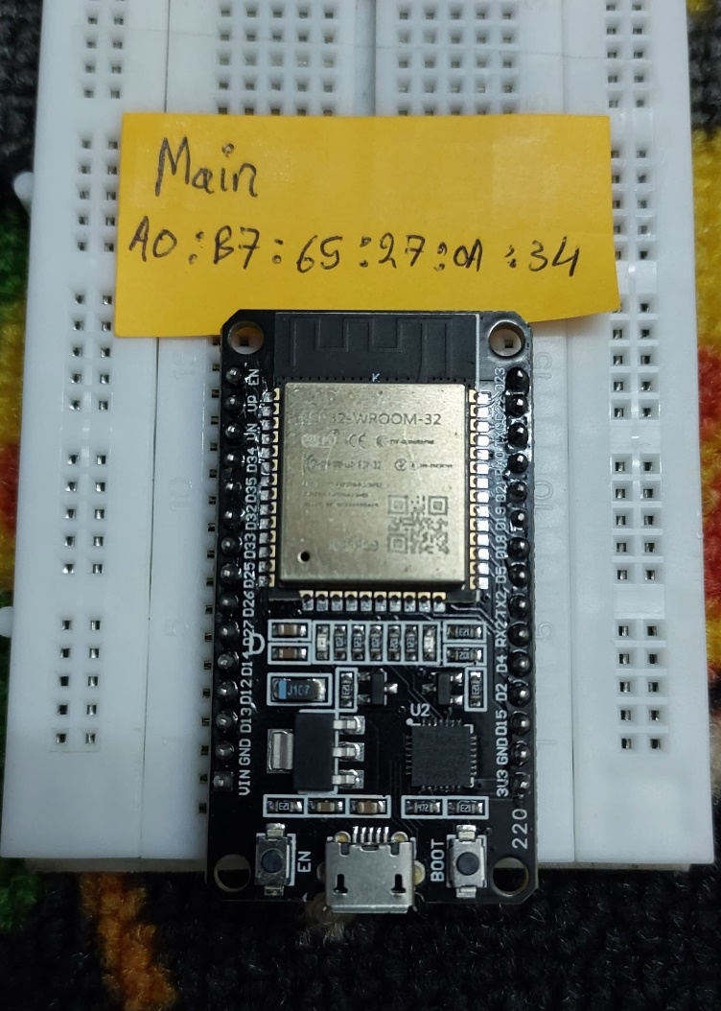
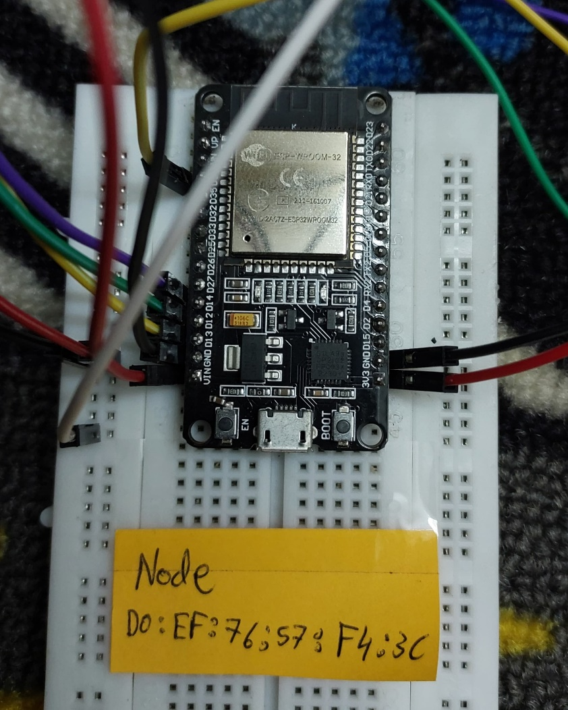
Tools and Techniques Used
Images
Main/Nodal ESP32 assembly

Slide 16
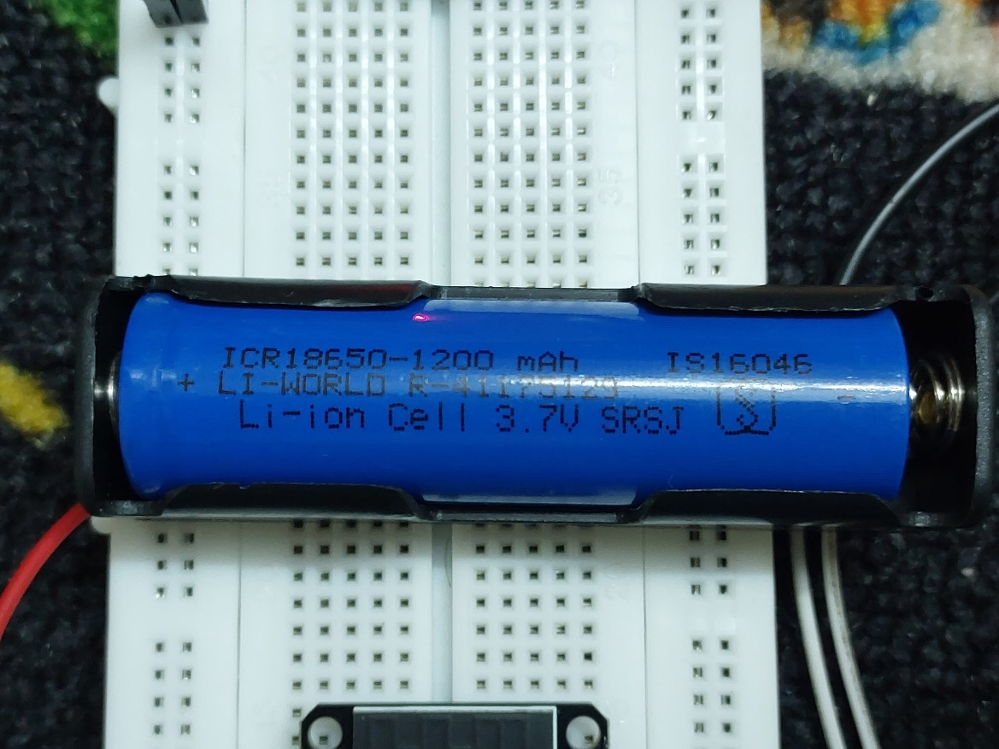
Tools and Techniques Used
Images
18650 Li-ion Battery

Slide 17
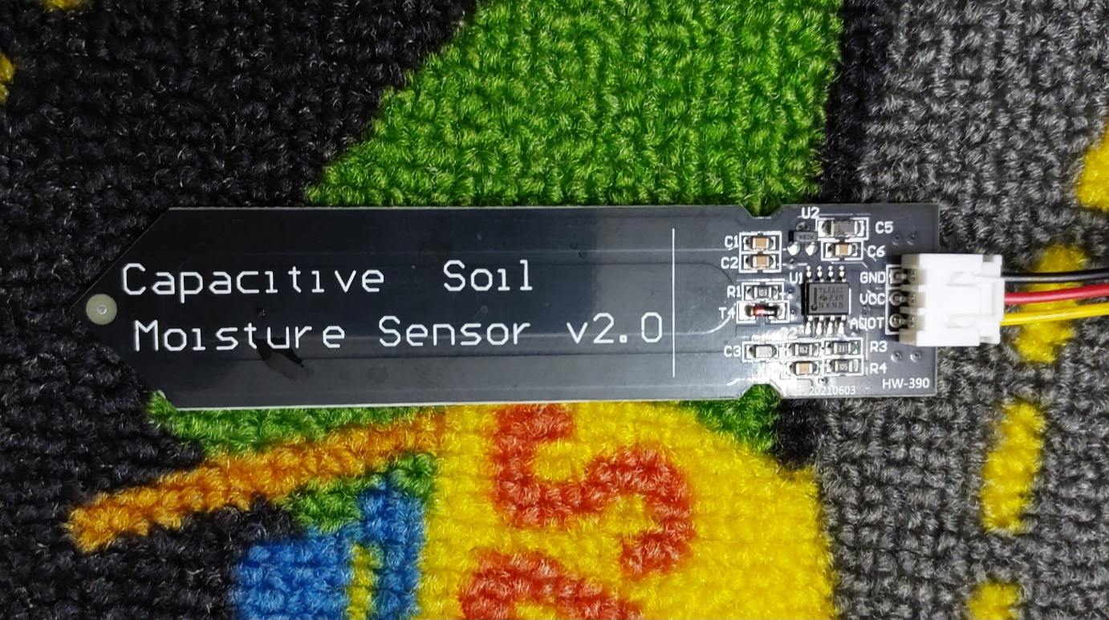
Tools and Techniques Used
Images
Capacitive Moisture Sensor ( 662k & TLC555I )

Slide 18
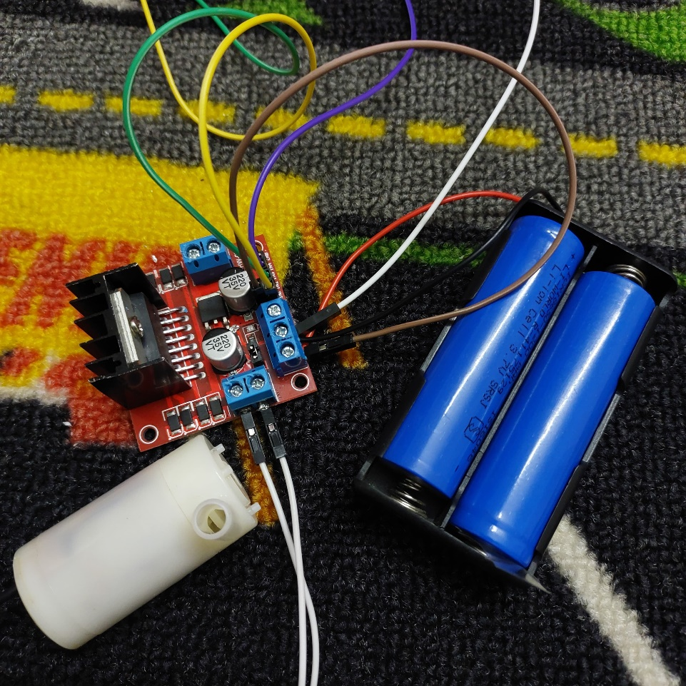
Tools and Techniques Used
Images
Motor Driver and Water pump (for demo, not part of project)

Slide 19
Project Progress
We developed a prototype using two ESP32 modules. The main module transmits data (on/off) to the node module.
The node module collects moisture data and transmits it back to the The main module which prints it after small intervals in the serial output of the Arduino IDE.
Additionally, the node module (will control) water flow using a relay connected to a water pump (demo setup), which will eventually integrate with existing water pumps in agricultural fields.
This setup effectively demonstrates the connectivity between modules, highlighting the system's scalability for larger field deployments.
Milestones achieved- Data Communication, Basic Automation, Scalability

Slide 20
Project Progress
Challenges Faced
Powering the Node Module: Developing a reliable battery-powered solution for the nodal module to ensure portability and long-term operation.
Communication Efficiency: Establishing stable and efficient communication between the main module and nodes over a suitable distance.
Component Selection: Identifying and sourcing components with the appropriate chipsets and resistors to ensure compatibility and optimal performance.

Slide 21
Analysis of Partial Results
1. Initial Prototypes
Developed a working prototype featuring two ESP32 modules:
Main Module:Receives soil moisture and showcases in SERIAL MONITER
Nodal Module: Collects soil moisture data and transmits it to the main module.(scalability and connectivity)

Slide 22
Analysis of Partial Results
2. Experimental Outcomes
ESP_NOW communication protocol works upto 200m with direct LOS and 150m with obstructions
II. Range can be extended upto 1.5km using LoRa module
III. Capacitive Moisture sensor with 662k voltage regulator and TLC555I chip is used for consistant readings under battery operation.
IV. Moisture sensor gives integer reading between 1000 (extreme wet condition) to 3500 (extreme dry condition)

Slide 23
Analysis of Partial Results
2. Experimental Outcomes
V. Power consumption under normal active condition is around
200-300mA at 5V and 100mA-200mA at 3.3V (measured with multimeter and shunt)
VI. Power Consumed in DEEP SLEEP MODE is around 10µA
So Considering the Battery’s self-Discharge rate
(2%/month for 1200mAH is 24mAh ) and voltage regulator AMS1117 power consumption (2mA)
The device can be powered for ~25 days without any charging from solar

Slide 24
Analysis of Partial Results
Portability and Compactness:
The prototype demonstrates portability and compactness;
The jumper cables used can easily be soldered into a custom PCB making the setup much more compact and small.
Energy Management:
Addressed initial challenges in powering the nodal module, laying the groundwork for integrating solar-powered solutions in future phases.

Slide 25
Analysis of Partial Results
Insights Gained:-
The prototype confirms the feasibility of the system for field conditions, validating its scalability for larger agricultural areas.
Identified areas for further improvement, such as optimizing power consumption and enhancing the durability of the modules.

Slide 26
Deliverables and Outcomes
Key Deliverables
Prototypes
Main Module: Designed and developed a functional prototype using ESP32 for data Transmission/Recieving.
Nodal Module: Developed and integrated a node that collects soil moisture, which transmits to the main module.
Water Control System: Implemented a relay-based water pump system to demonstrate
irrigation control in response to real-time data.
Ability to implement and improvise based on any irrigation setup

Slide 27
Deliverables and Outcomes
Key Deliverables
Communication and Data Transmission Models
Established reliable communication between two ESP32 modules, ensuring seamless data transmission across the system.
Simulations and Preliminary Testing
Performed initial functionality tests to ensure system stability, data transmission accuracy, and proper water control.
Validated the scalability of the system by demonstrating the effective operation of multiple nodes.

Slide 28
Deliverables and Outcomes
Key Deliverables
Quality and Scope
The prototypes meet initial design goals for connectivity and water management.
The scope includes a compact, scalable solution that can be expanded with additional nodes and sensors.
The prototypes show robust data transmission capabilities, indicating the system’s readiness for real-world applications.
Contribution to Larger Goals
These deliverables form the foundation for the next phases, focusing on testing in real agricultural environments, system optimization, and scaling up to meet industry needs.
The demonstration of real-time data-driven irrigation control aligns with the project's primary objective of water and resource optimization for smallholder farmers.

Slide 29
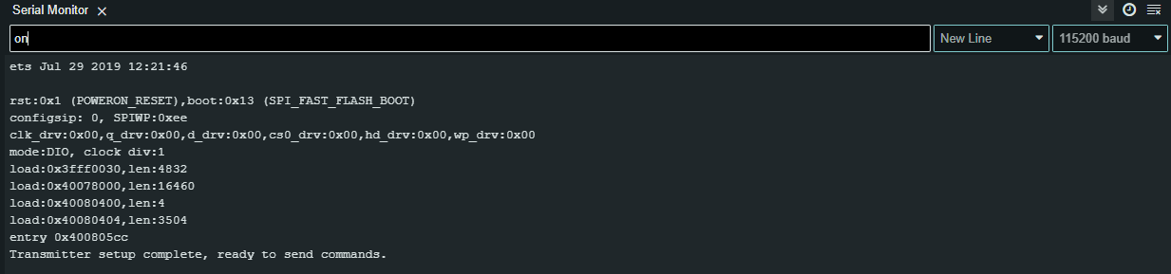
Deliverables and Outcomes
Visual Documentation (Main)
Screenshot of serial moniter -demonstrating Connectivity and –real time data transmition

Slide 30
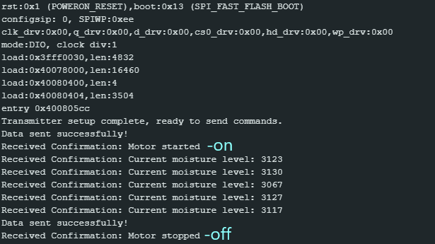
Deliverables and Outcomes
Visual Documentation (Main)
Screenshot of serial moniter -demonstrating Connectivity and –real time data transmition

Slide 31
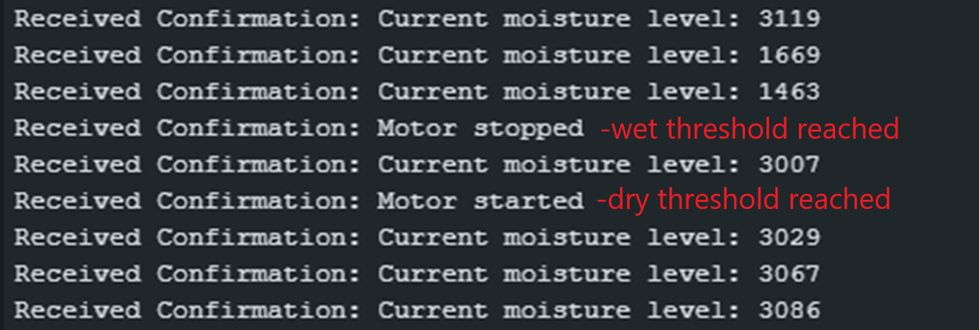
Deliverables and Outcomes
Visual Documentation (Main)
Motor is stopped when wet threshold is reached, and started when dry threshold exceeded

Slide 32

Deliverables and Outcomes
Visual Documentation (Node)
Nodal module recieves ‘on’ or ‘off’ from main module and activates system, and sends analogue reading to main module

Slide 33
Future Work (Remaining Tasks)
Next Steps
Integrate solar panels into each nodal module for sustainable energy solutions.
Design and 3D-print custom enclosures for all modules and nodes, ensuring durability and portability.
Conduct extensive field testing in real-world agricultural settings to evaluate performance under varying conditions
Finalize the user interface for seamless data access and insights

Slide 34
Future Work (Remaining Tasks)
2. Pending Tasks
Comprehensive testing and calibration of sensors
Mapping and matching sensor readings with different soil types
Find efficient voltage regulator to power the micrcontroller with a battery
Optimization and making of communication protocols between nodes and the central module.

Slide 35
Future Work (Remaining Tasks)
3. Expected Timeline
Week (9 to 10) - Field Testing and Refinements
Begin extensive field testing and irrigation control.
Implement solar panels to make the modules self-sustaining.
Design custom 3D-printed casings for modules to protect components.
Week (11 to 12) –
Conduct final tests to evaluate system performance in various conditions.
Create and store moisture sensor data based on different types of soil
Integrating additional sensors if possible in the timeframe

Slide 36
Future Work (Remaining Tasks)
3. Expected Timeline
Week (13+)
Website Development:
Build a mobile-responsive website for remote monitoring and control.
Integrate cloud services for data storage and retrieval.
Testing and Integration:
Test UI and website functionality, gather feedback, and make improvements.
Integrate UI/website with the hardware system for real-time control.

Slide 37
Future Work (Remaining Tasks)
4. Challenges
Ensuring reliability/functioning of system under different and extreme environmental conditions
Shielding sensitive electrical components from outer environmental conditions
Designing waterproof 3D model of casing for nodal modules and finding waterproof filament for 3d-printing
Finding power efficient voltage regulators to avoid losses as system runs on battery power

Slide 38
Conclusion
In Phase-II we demonstrated the prototype's functionality/scalability/portability/affordability ,providing a strong foundation for Phase-III.
The successful demonstration allows us to move into real-world testing, where we'll integrate solar panels for energy efficiency and design custom 3D-printed casings for durability.
Challenges faced and insights gained in Phase-II will help refine the system for large-scale deployment, ensuring it's practical and reliable for diverse farming environments.
Key takeaway- The importance of balancing cost-effectiveness without compromising on functionality and the need for adaptability.

Slide 39


